Slide 1
EyeFi: Fast Human Identification Through Vision and WiFi-based Trajectory Matching
Shiwei Fang*, Tamzeed Islam*, Sirajum Munir^, and Shahriar Nirjon*
* University of North Carolina at Chapel Hill
^ Bosch Research and Technology Center, Pittsburgh

Slide 2
Problem
How to enable reliable long-term person identification despite of appearance changes?
Same Person
May Appearance
August Appearance
Can we identify him as the same person?

Slide 3
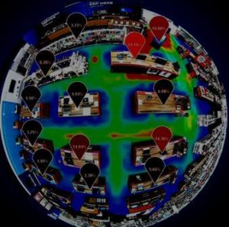
Motivation
Re-identification enables understanding of fine-grained shoppers’ behaviors in retail stores.
Customer retention rate/visit frequency/time spent.
Optimal layout to maximize profit based on behaviors.
Targeted messages to engage with customers.

Slide 4
Motivation cont.
Improving public safety during an active shooter scenario with targeted messages and information.
Identification enables customized message for individual’s evacuation route to avoid direct confrontation.

Slide 5
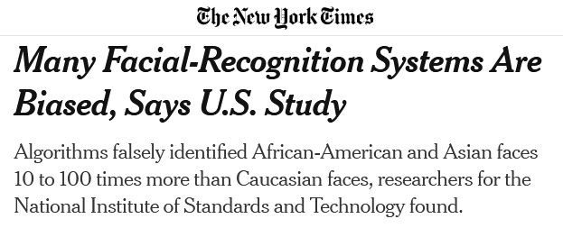
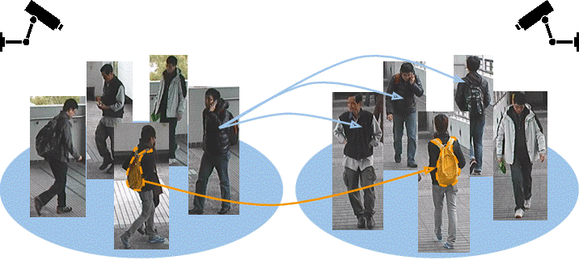
State of the Art
Camera based¹:
Facial recognition is privacy invasive.
Banned in cities.
Bias and accuracy concerns.
Re-identification un-reliable across time with different appearance.
Ultrasonic based²:
Does not scale across thousands of people.
Liao, Shengcai, et al. "Person re-identification by local maximal occurrence representation and metric learning." Proceedings of the IEEE conference on computer vision and pattern recognition. 2015.
Khalil, Nacer, et al. "Sonicdoor: scaling person identification with ultrasonic sensors by novel modeling of shape, behavior and walking patterns." Proceedings of the 4th ACM International Conference on Systems for Energy-Efficient Built Environments. 2017.

Slide 6
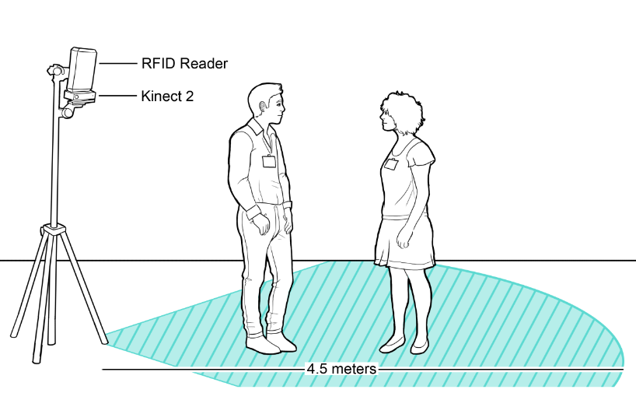
State of the Art cont.
Fusion of Camera and RFID¹:
Requires additional hardware.
WiFi only²:
WiFi packets sniffing, Coarse-grained localization.
Fined-grained localization requires installation of multiple devices and maintenance.
Li, Hanchuan, et al. "Id-match: A hybrid computer vision and rfid system for recognizing individuals in groups." Proceedings of the 2016 CHI Conference on Human Factors in Computing Systems. 2016.
Vasisht, Deepak, Swarun Kumar, and Dina Katabi. "Decimeter-level localization with a single WiFi access point." 13th {USENIX} Symposium on Networked Systems Design and Implementation ({NSDI} 16). 2016.

Slide 7
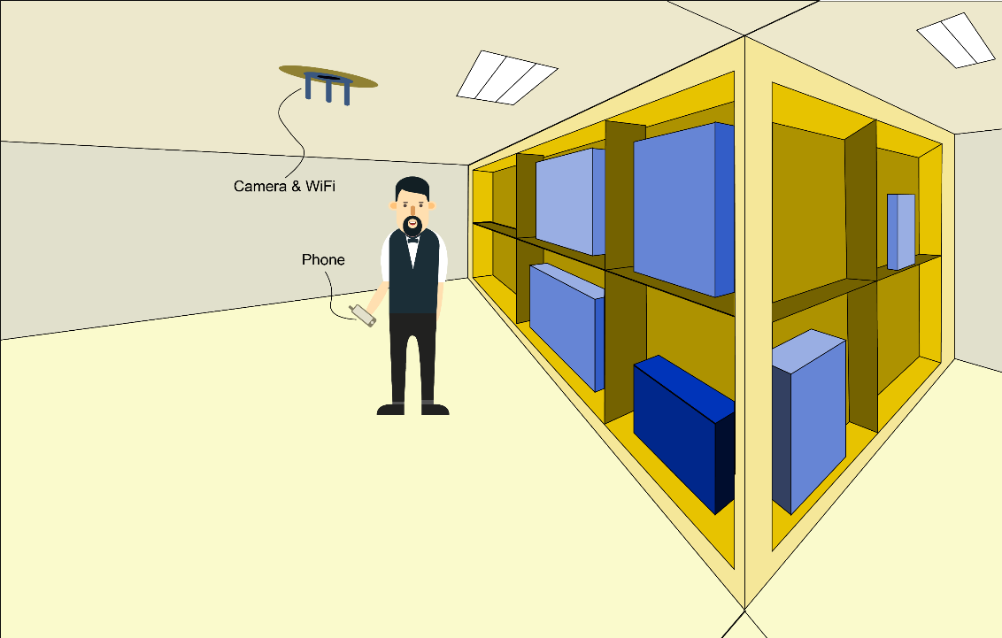
EyeFi Overview
Novel system that fuses WiFi and camera for person identification: EyeFi.
Enables reliable long-term re-identification.
Requires no facial recognition.
Can be standalone devices.
Cross modal trajectory matching across WiFi and camera.
Leverages MAC addresses of WiFi interfaces of smartphones.

Slide 8
Outline
Introduction
Proposed Solution
Experimental Setup
Results

Slide 9
2
Proposed Solution

Slide 10
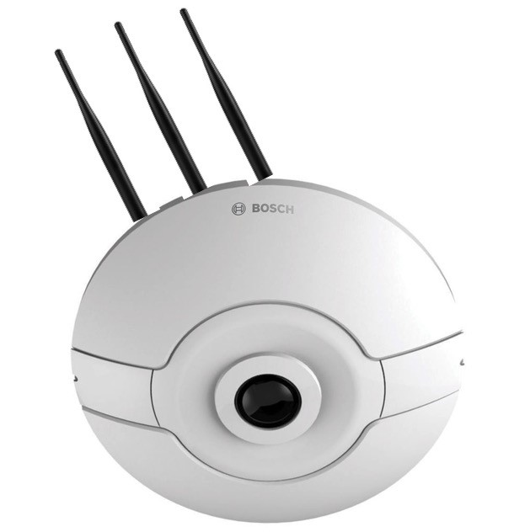
EyeFi – Architecture
1
Camera Pipeline
Person Detection, Localization
AoA Estimation
Trajectory Matching
Person Identification
WiFi Pipeline
CSI AoA Estimation
Smoothing
4
2
3

Slide 11
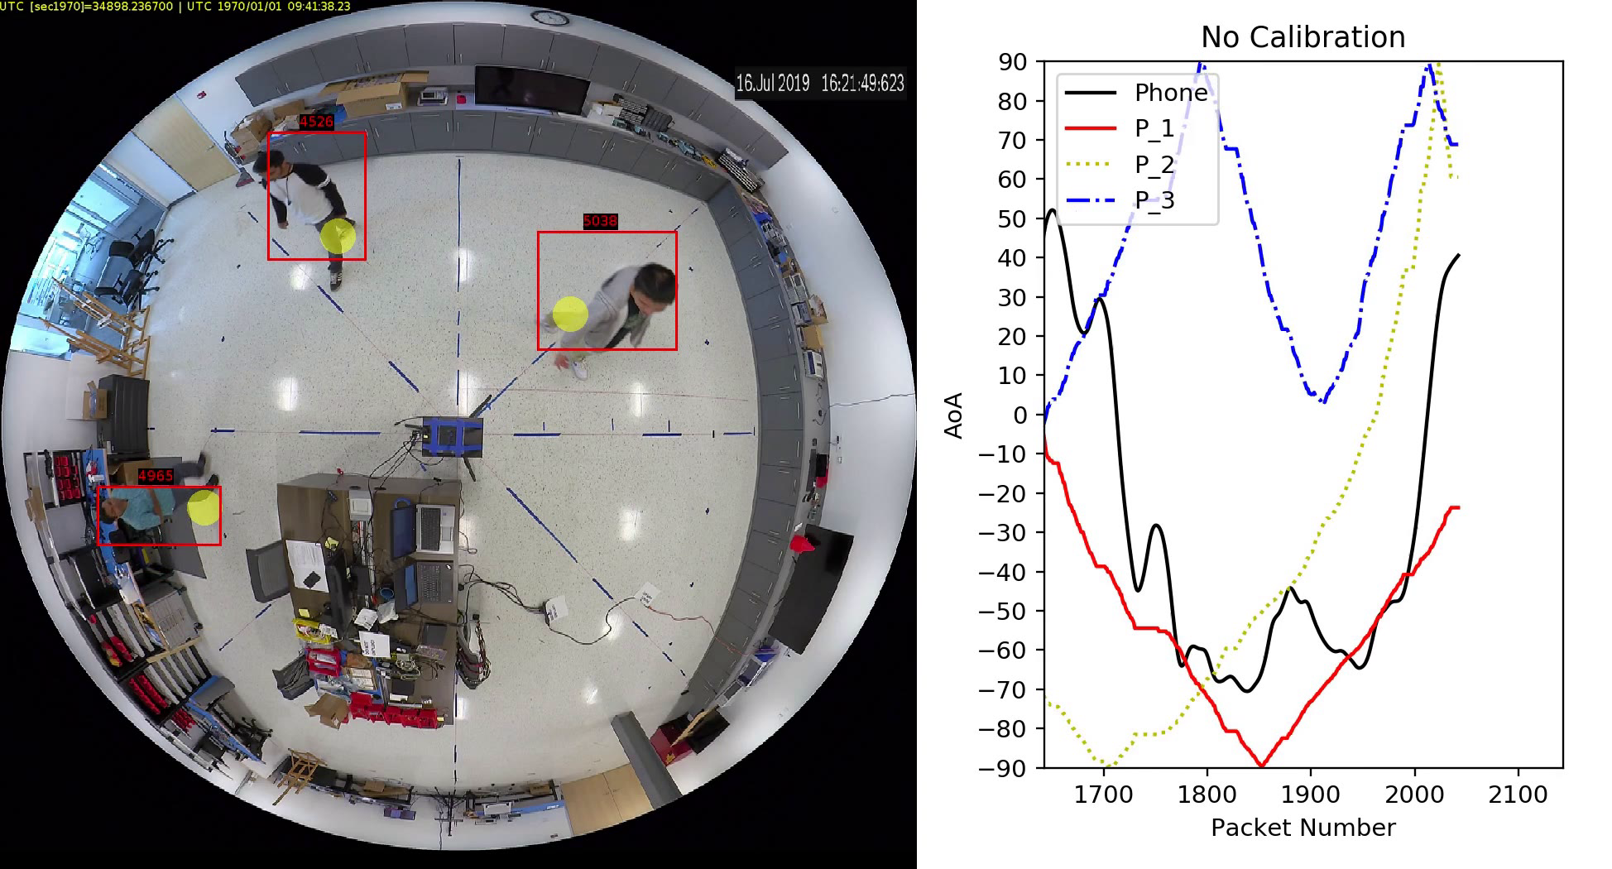
1. Camera AoA
Bosch Flexidome IP Panoramic 7000 provides human detection and location in (x,y) coordinates.
The coordinates are where the person’s foot are (yellow dot in the image).
The (x,y) coordinates can be converted into AoA of high accuracy.
We use AoA provided by camera as ground truth.

Slide 12
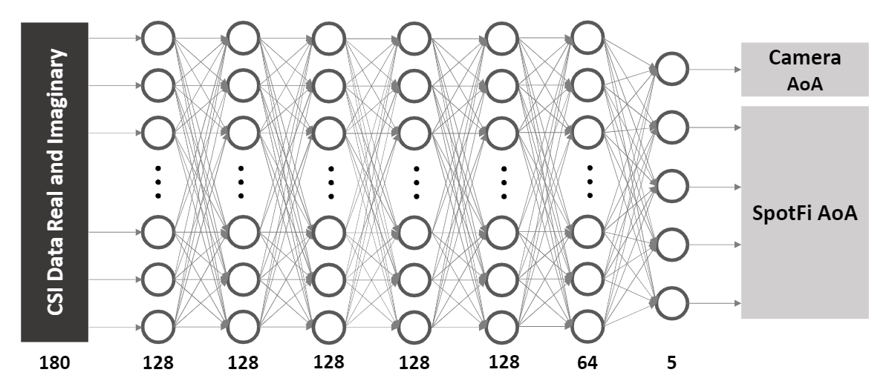
2. WiFi AoA Estimation
CSI contains how signals propagates which can be used to estimate the AoA based on difference of WiFi signals across 3 antennas.
Neural network for fast estimation.
Use Channel State Information (CSI) as input.
Teacher-student model.
SpotFi¹ as soft labels.
Ground truth AoA
The network is forced to learn multi-paths.
Generalizes to unseen environment.
Kotaru, Manikanta, et al. "Spotfi: Decimeter level localization using wifi." Proceedings of the 2015 ACM Conference on Special Interest Group on Data Communication. 2015.

Slide 13
Estimated AoAs are Noisy
Causes for noise in AoA estimation:
Data collection noise
Estimation noise
Camera AoA Ground Truth
WiFi AoA Estimation
Estimation
From SpotFi
Estimation
From NN

Slide 14
3. AoA Smoothing
Standard smoothing algorithms do not work (i.e. moving average).
We propose variance based smoothing.
Define a smoothing window $X$ with $N$ data points, and calculate the variance of the smoothing window with and without the targeted smoothing data point $xt∈X$:

Slide 15
3. AoA Smoothing cont.
Then we find the different between the two variances:
We replace the targeted smoothing data point with:
Refer to paper about how $μXbiased$ is calculated.

Slide 16
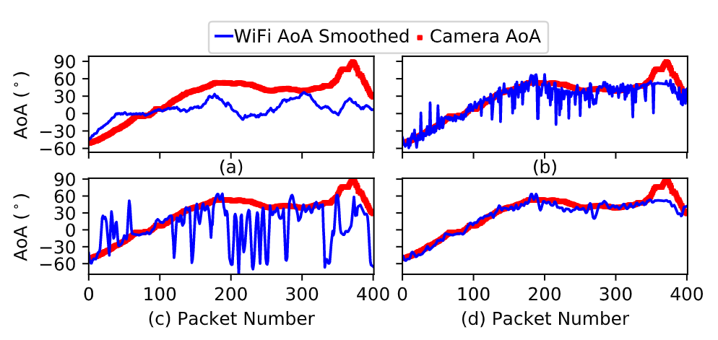
3. AoA Smoothing cont.
After our variance-based smoothing, we apply LOWESS to get better results.
We show the differences between different smoothing algorithms:
Moving Average
Variance-based
LOWESS
Variance-based + LOWESS
(Our approach)
LOWESS: Locally Weighted Scatterplot Smoothing

Slide 17
4. Trajectory Matching
Euclidean distance on larger amount of packets.
Using polynomial fitting on smaller amount of packets.
Angle may be different but trend is similar.
We fit data of matching windows size $N$ with:
The estimated y data points are used for calculating the distance.

Slide 18
4. Trajectory Matching
We also use weighted distance for polynomial fitting:
Absolute rate of change every data point R_{i}

Slide 19
3
Experimental Setup

Slide 20
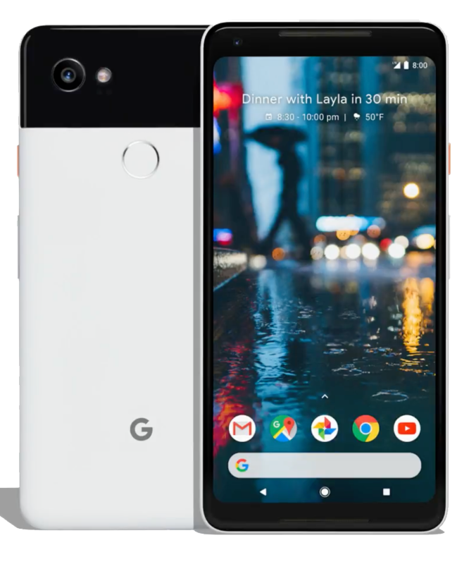
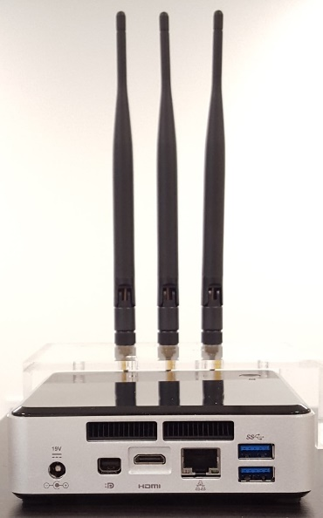
Hardware
Intel NUC with Intel 5300 WiFi card
Bosch Flexidome IP Panoramic 7000
Google Pixel 2 XL

Slide 21
Data Collection Environment
Different number of people (1,2,3,5,10) in the scene.
Only one person holding the phone.
Pixel 2 XL smartphone as AP, Intel 5300 WiFi chip as client.
~ 20-25 WiFi packets per seconds.
Two different areas for different RF characteristics.
Dataset available!
https://zenodo.org/record/3882104

Slide 22
4
Results

Slide 23
Evaluation Criteria
Evaluate performance of neural network AoA estimation.
Evaluate performance of smoothing techniques.
Evaluate identification accuracy with different number of people.

Slide 24
Results – Neural Network AoA Estimation Accuracy
Evaluate the accuracy of AoA estimation.
EyeFi (SpotFi + camera neural network) achieves minimal Mean and Median AoA errors.
Neural network also provides over 3800x speed up over SpotFi.

Slide 25
Results – Neural Network AoA Estimation Generalizability
Training with only data from Lab area.
Test with data from both Lab and Kitchen area.
EyeFi (SpotFi + camera neural network) generalizes to unseen environment.

Slide 26
Results – Smoothing
Our variance based smoothing with LOWESS achieves the best performance in terms of Mean and Median AoA errors.

Slide 27
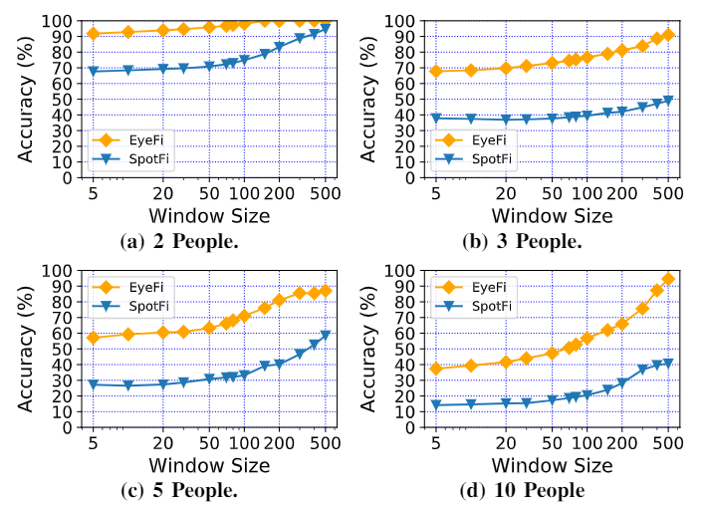
Results – Identification Accuracy
We evaluate the identification accuracy with different crowd size (2,3,5,10) and number of transmitted WiFi packets (window size).
EyeFi (NN + Smooth + Camera) achieves 75% accuracy and performs better than SpotFi (SpotFi + Camera).
5 WiFi packets is roughly 0.05s

Slide 28
Conclusion
We proposed a multi-modal sensing system that fuses WiFi and camera for human sensing, motion trajectory estimation, and long-term identification.
We developed a student-teacher based neural network to estimate AoA from CSI values and proposed a novel techniques to smooth the WiFi-based trajectory.
Our system provides over 3800x speedup and 75% overall accuracy which is faster and better than SpotFi based approach.
We collected real-world dataset and released it for public.

Slide 29
Thanks!
Questions?

Slide 30
Backup Slides

Slide 31
Background – CSI
CSI – Channel State Information
known channel properties of a communication link.
Phase and amplitude can be different across multiple paths.
Wall
Wall

Slide 32
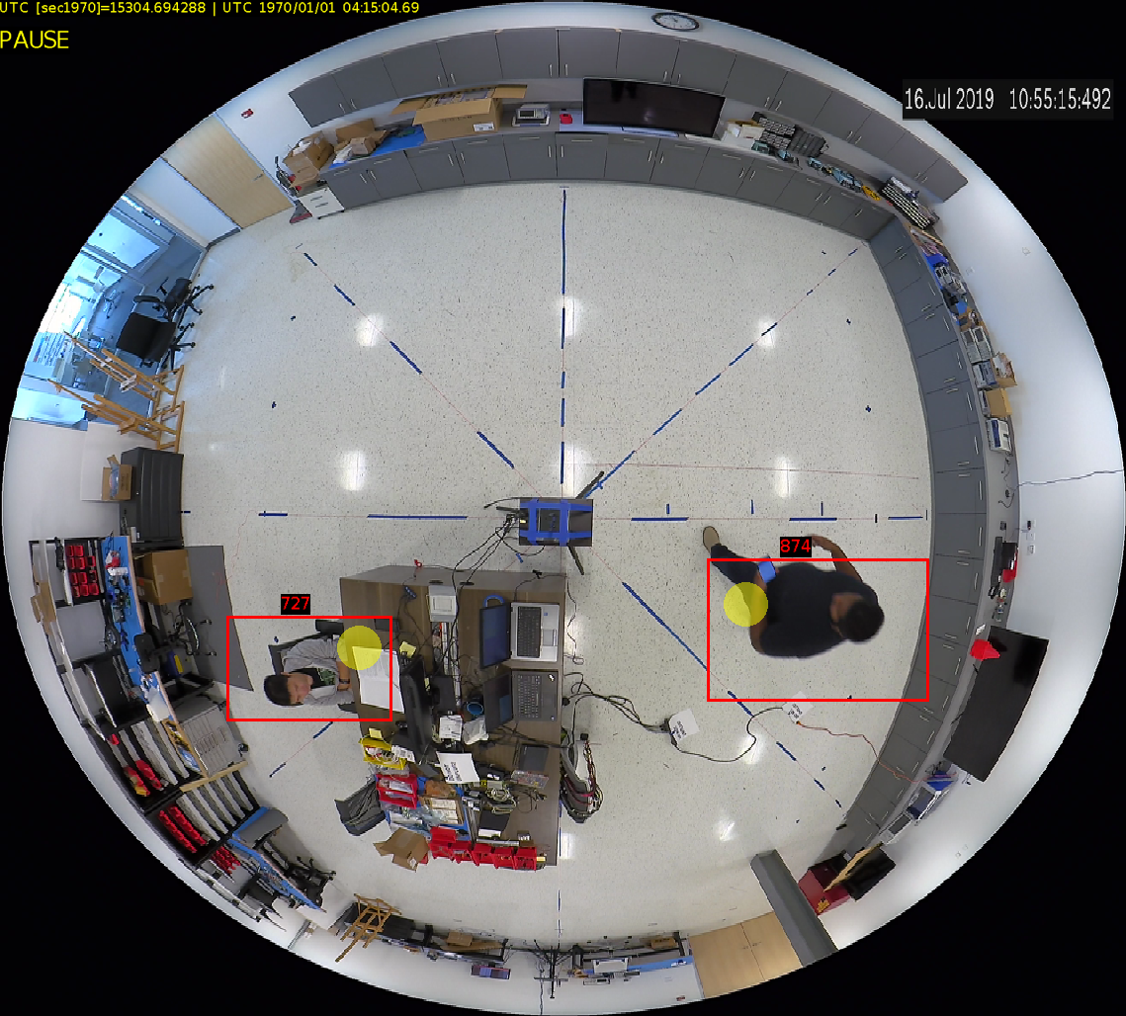
Background – Angle of Arrival (AoA)
Angle of Arrival (AoA)
How to get CSI to AoA?
Received WiFi signal difference across different antennas.
State of the art: SpotFi
Kotaru, Manikanta, et al. "Spotfi: Decimeter level localization using wifi." Proceedings of the 2015 ACM Conference on Special Interest Group on Data Communication. 2015.

Slide 33
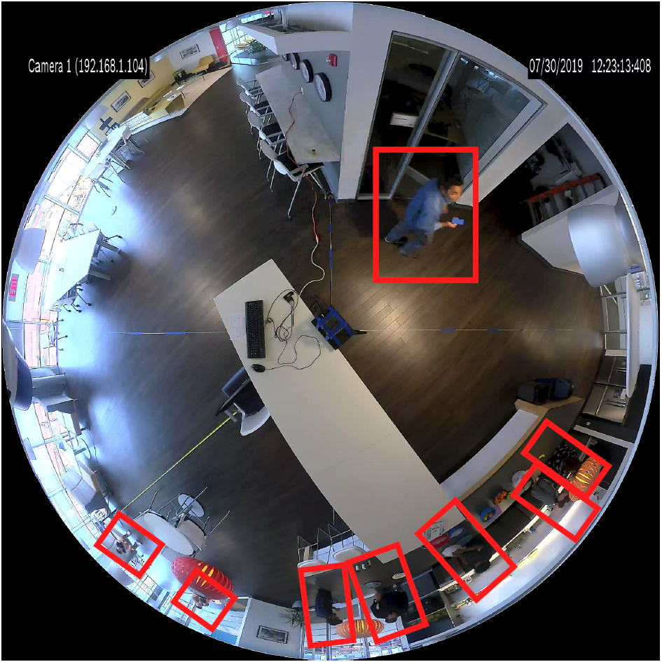
Why Not Vision or SpotFi + Vision
Facial recognition is privacy intrusive and banned in certain situations.
Not working well with panoramic camera.
SpotFi is slow.. 1-1.5 second per packet
We use a low data rate of around 23 packets per second.
8 hours video requires 184 hours (7.67 days) to calculate.

